Slide 1

Restaurant Management System - "RU Hungry"
Welcome to "RU Hungry," a console-based C application meticulously designed to simulate a comprehensive restaurant management system. This presentation will delve into its architecture, showcasing how robust data structures like Queues and Binary Search Trees power efficient operations from customer seating to real-time menu management and order processing.
Project Overview
Console-based C application for restaurant operations
Queue-based customer seating management
Binary Search Tree (BST) for efficient menu management
Real-time stock tracking and order processing
Dynamic menu operations (add/delete items)
Problem Statement
Seating customers with waiting queue
Dynamic menu with real-time stock tracking
Processing orders with availability checks
Deducting stock, rejecting unavailable items
Managing departures and table allocation
Generating bills for customer orders

Slide 2

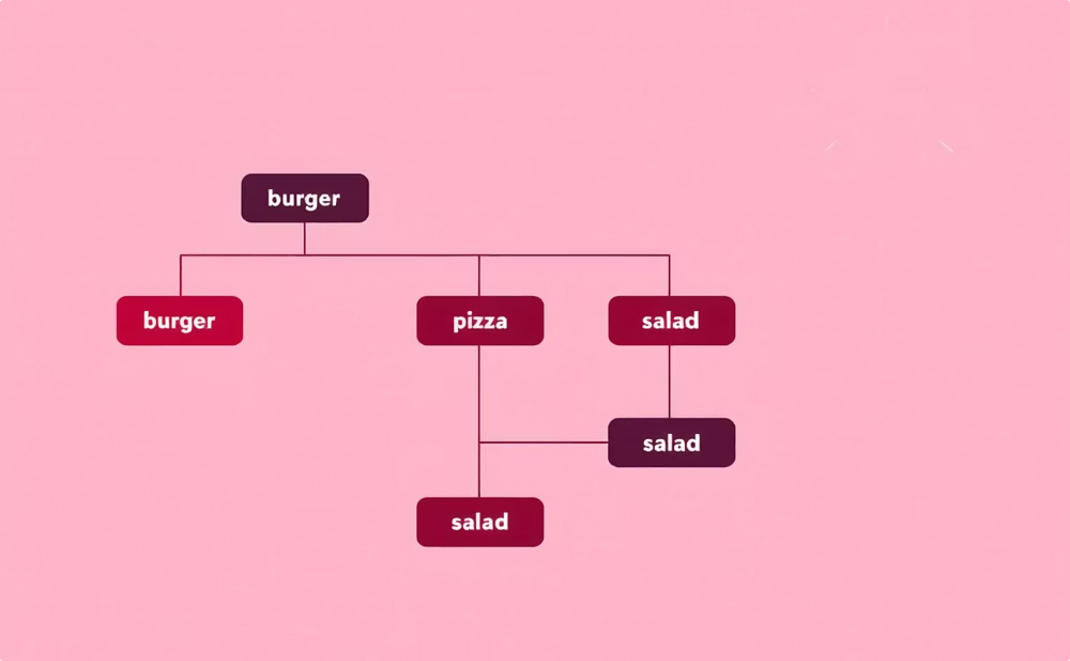
Data Structures Driving "RU Hungry"
The efficiency and responsiveness of the "RU Hungry" system are underpinned by the strategic application of fundamental data structures: Queues and Binary Search Trees (BSTs).
Queue (Linked List)
Binary Search Tree (BST)
Manages customer waiting lines and ensures fair, first-come-first-served seating. Its O(1) enqueue and dequeue operations guarantee rapid customer flow.
Efficiently stores and manages menu items. With average O(log n) search complexity, it allows for quick lookup, insertion, and deletion, and automatically provides a sorted menu display.
Key Benefits
Fair customer service (FIFO)
Fast menu item lookup
Dynamic size (no fixed limits)
Memory efficient pointer-based implementations

Slide 3





Customer Flow Management: The Queue ADT
The Queue Abstract Data Type (ADT), implemented as a singly linked list, is central to managing customer traffic. It ensures a smooth and fair seating process, handling arrivals, departures, and waiting lists with optimal efficiency.
insertQueue()
Adds new customers to the waiting line. Assigns unique customer numbers and maintains the first-in-first-out (FIFO) order. O(1) complexity.
deleteQueue()
Removes customers from the front of the queue once a table becomes available. Critical for moving customers from waiting to seated. O(1) complexity.
main_seating_algo()
Orchestrates seating: if seats are available, a customer is seated; otherwise, they are added to the waiting queue. Handles capacity checks. O(1) complexity.
customer_leaves()
Processes customer departures, freeing up tables and automatically seating the next waiting customer from the queue. O(1) complexity.
Global Constants:
MAX: 20 (Maximum capacity for seats and queue)
available_seats: Tracks total seating capacity
available_queue: Tracks waiting queue capacity

Slide 4
Menu Management: The Binary Search Tree ADT
The Binary Search Tree (BST) ADT is the backbone of our dynamic menu system, offering efficient storage and retrieval of menu items. Its inherent ordering allows for quick access and a naturally sorted display.
1
createMenuItem()
Allocates memory and initializes a new menu item node with its name, price, and stock quantity. O(1) complexity.
2
addItem()
Inserts new items or updates stock for existing ones. Uses string comparison for proper BST placement. Average O(log n).
3
searchItem()
Locates menu items quickly by name. Essential for order processing and stock checks. Average O(log n).
4
deleteItem()
Removes menu items while maintaining BST integrity, handling various node deletion scenarios. Average O(log n).
5
updateStock()
Deducts stock when an order is placed, verifying availability to prevent overselling. O(log n) due to search.
6
displayMenu()
Performs an in-order traversal to show all menu items alphabetically, including their price and current stock status. O(n).

Slide 5
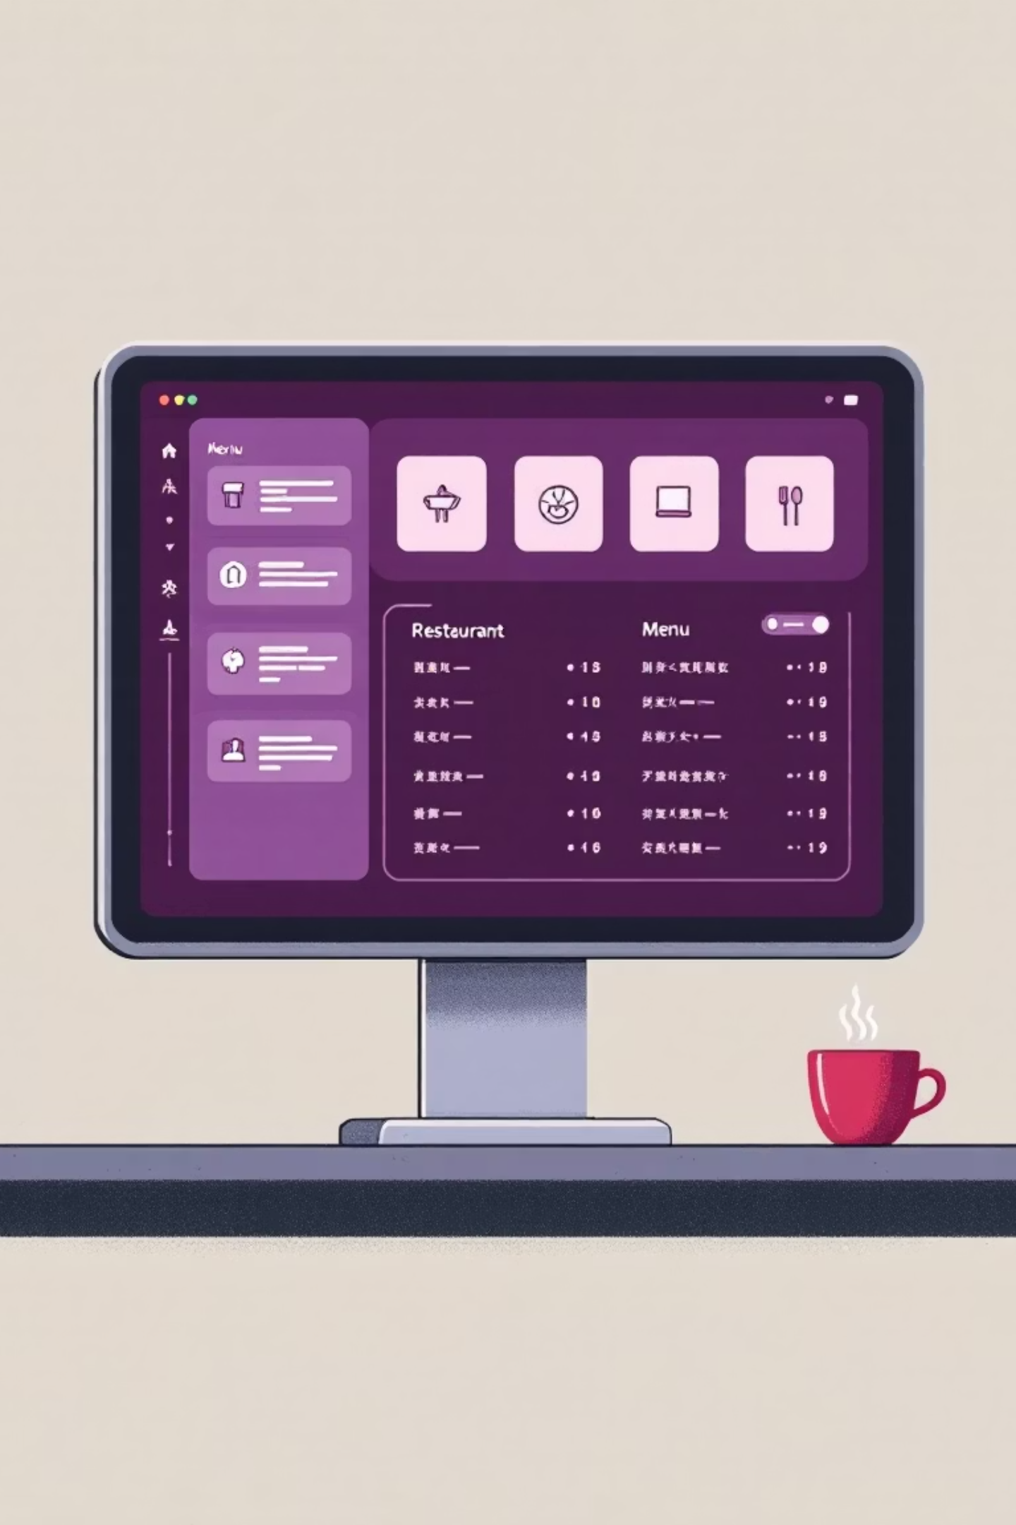




System Interaction: Functional Snapshots
The "RU Hungry" system provides a clear, console-based interface for all restaurant operations. Here's a glimpse into its core functionalities.
Main Menu Display
Eight intuitive options for customers, seating, menu, and orders. Clear navigation for seamless operation.
Menu Items Display
Alphabetically sorted list of items, showing price, item name, and stock status. "OUT OF STOCK" clearly marked.
Order & Bill Generation
Processes customer orders, deducting stock, and generates a detailed bill with item quantities, prices, and line totals.
Stock Management
Facilitates adding, deleting menu items, and provides real-time stock updates. Notifies users of stock levels during orders.
The system also clearly communicates customer seating status, including available seats and the waiting queue.

Slide 6
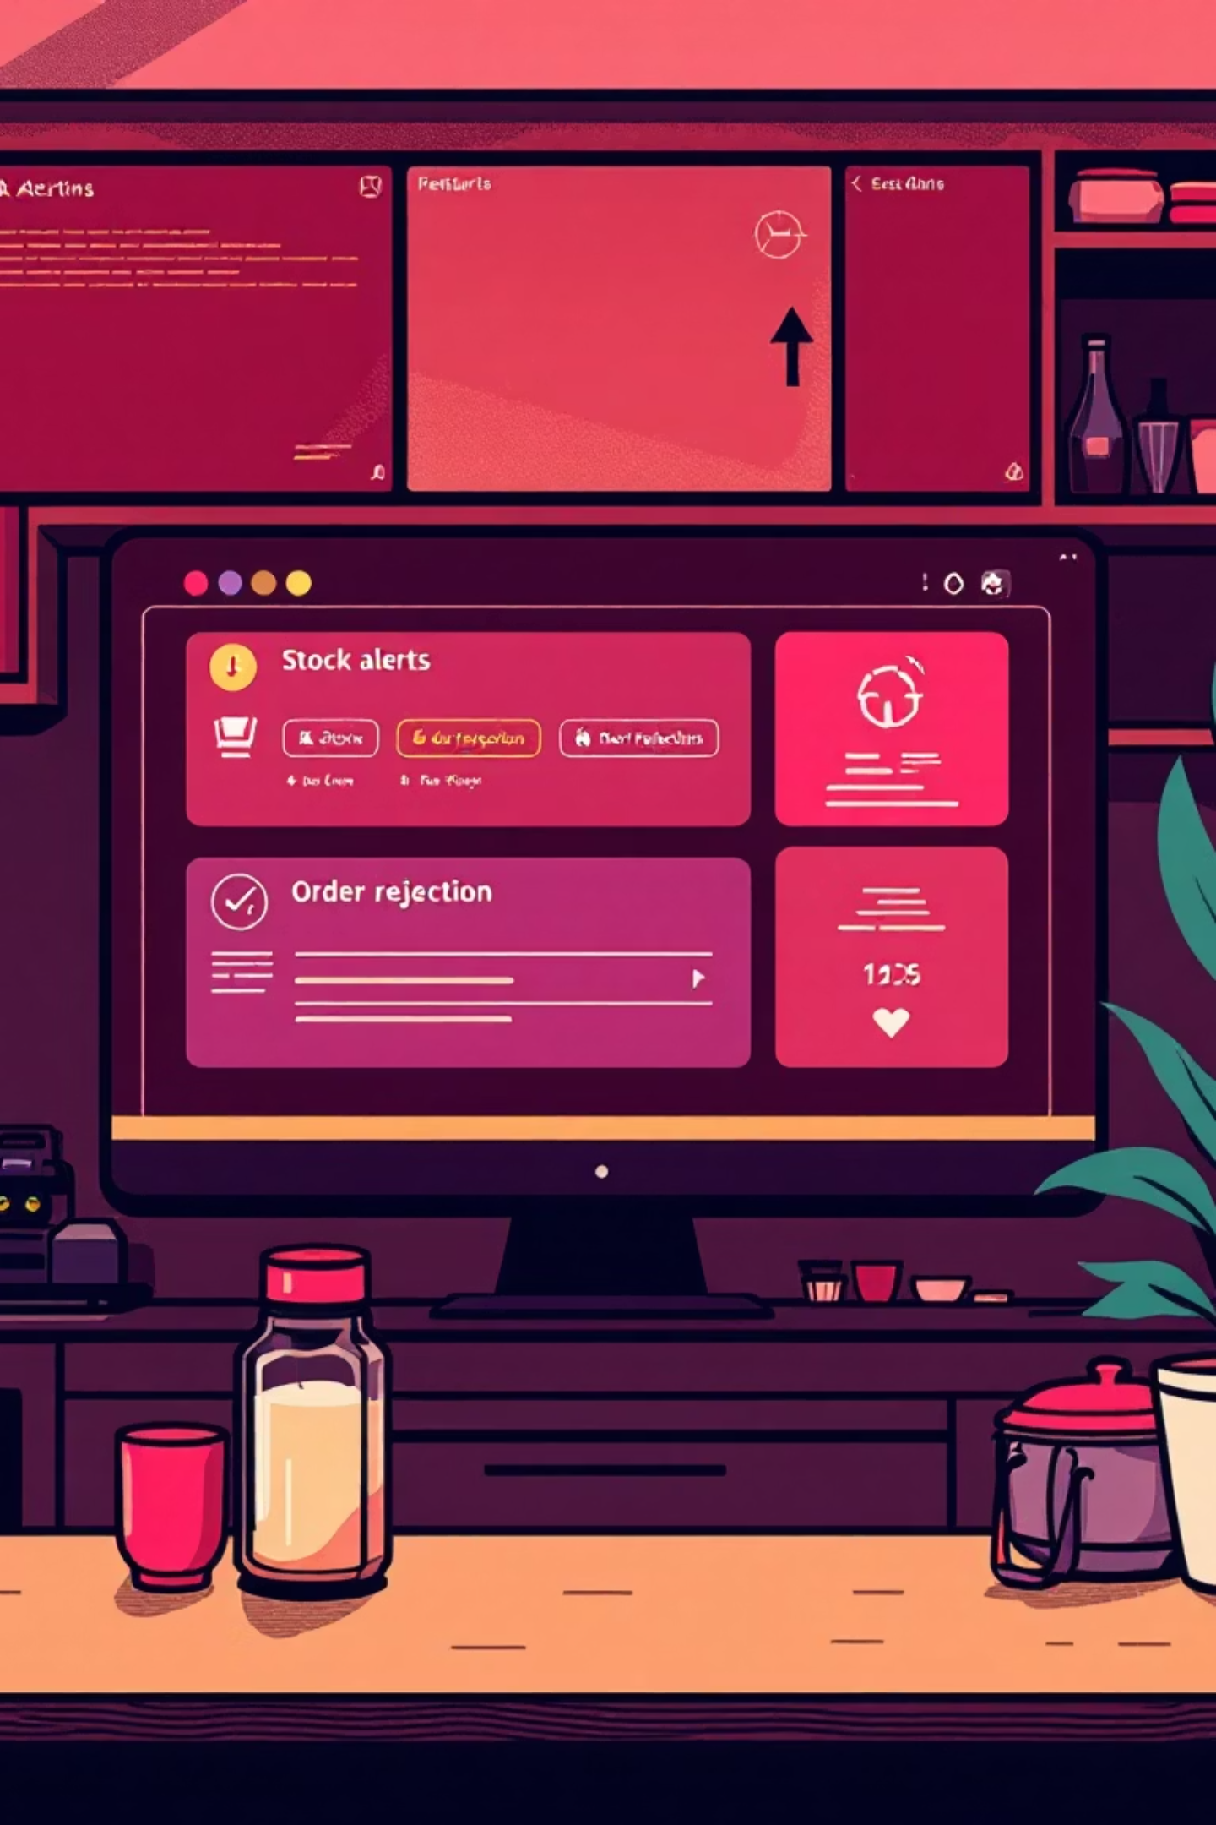




Robustness in Action: Advanced Features
Beyond core functionalities, "RU Hungry" incorporates advanced features to handle dynamic scenarios and potential edge cases, ensuring reliability and a smooth user experience.
Stock Rejection
Prevents overselling by rejecting orders when stock is insufficient, providing immediate feedback without altering inventory.
Dynamic Menu Operations
Allows real-time modification of the menu, including adding new items or removing outdated ones, with an automatically updated, sorted display.
Fair Queue Management
Maintains customer fairness by handling multiple customers in the waiting queue, seating them sequentially as tables become available.
Comprehensive Error Handling
Robust checks for invalid inputs, out-of-stock scenarios, and other user errors, guiding the operator with clear messages.

Slide 7





Behind the Scenes: Code & Algorithms
Understanding the underlying algorithms and data structures is key to appreciating the system's efficiency and reliability. Let's look at some critical implementations.
Queue Node Structure
BST Menu Item Structure
typedef struct Queue { struct Queue *next; int seats; int customer_number;} QUEUE;
typedef struct MenuItem { char itemName[100]; float price; int stockQuantity; struct MenuItem *left; struct MenuItem *right;} MenuItem;
A singly linked list node for each customer in the queue, tracking their number and allocated seats.
Each node in the BST represents a menu item, holding its details and pointers for tree traversal.
Manage Queue
Check or add to queue
Seat Customer
Assign available seat
Check Seats
Are seats available?
Start
Begin seating process
This flowchart illustrates the decision-making process for customer seating, prioritizing available tables and then the waiting queue.

Slide 8
Algorithmic Efficiency: Time Complexities
Efficiency is paramount in a real-time management system. Here, we highlight the time complexities of critical operations, demonstrating "RU Hungry"'s responsiveness.
O(1)
O(log n)
O(n)
Queue Operations
BST Search
Display Menu
Enqueue and Dequeue for customer management are constant time operations, ensuring minimal delay.
Searching for menu items, updating stock, and adding/deleting items typically take logarithmic time, scaling well with menu size.
Displaying the full menu requires visiting every node in the BST once for an in-order traversal.
The choice of data structures directly translates into a highly efficient system, capable of handling rapid operational demands without significant performance degradation.

Slide 9
Project Achievements & Key Learnings
The development of "RU Hungry" has been a journey of practical application and deep learning, yielding a functional system and valuable insights.
Implemented Core System
Efficient Data Structures
A fully functional console-based restaurant management system.
Mastered Queue (O(1)) and BST (O(log n)) for optimal performance.
Dynamic Management
Robust Error Handling
Real-time stock tracking and dynamic menu capabilities.
Comprehensive checks for various operational scenarios.
Key Learning Outcomes
Future Enhancements
Practical application of Queue and BST ADTs.
Multi-table management, transaction history.
Dynamic memory management in C.
Daily sales reports and persistent storage.
Modular programming and problem-solving with DSA.
Potential GUI implementation for enhanced user experience.

Slide 10




Team Contributions & Collaborative Success
The success of "RU Hungry" is a testament to effective teamwork, with each member contributing specialized skills and collaborative effort.
Team Member 1: Prajwal M
Designed and implemented the Queue data structure, customer seating algorithms, and queue management logic.
Team Member 2: R P Pranav
Developed the Binary Search Tree for menu management, including all menu operations, stock tracking, and updates.
Team Member 3:Nikitha V
Integrated the main program, crafted the user interface, and built the order processing and bill generation systems. Responsible for testing and documentation.
Our collaborative efforts, from initial problem analysis and system design to code integration and rigorous testing, were crucial in bringing "RU Hungry" to life.

